Slide 1
Source Code Plagiarisation and Detection
Avinaba Mistry 001010501008 Jadavpur University

Slide 2
Source Code Plagiarisation
Plagiarisation of source codes in a programming course involves students deliberately using materials from various sources without giving due credit.

Slide 3
Motivation
Tight Deadlines
Boring Assignments
Dishonest environment
Rigid drop policies
Inadequate consultants
Complete lack of interest (Lyadh)

Slide 4
Methods
Change file names.
Change comments.
Change case.
Reformat the code (input/output).
Reorder the code.
Add or delete redundant elements.

Slide 5
Distribution of problem sets duplication
Number of students with
One duplicate set | 26
Two duplicate sets | 22
Three duplicate sets | 20
Four duplicate sets | 11
Five duplicate sets | 1
Total students involved | 80
Case Study: MIT Spring 1990, course CE 1.00 - © Neal R. Wagner
http://www.cs.utsa.edu/~wagner/pubs/plagiarism.html#Table 4

Slide 6
Challenges
Source codes are different in nature of production and evaluation from other textual material.
Source codes contains special characters which creates the logic of a program, unlike proses.

Slide 7
Software based detection
MOSS :
Measure of Software Similarity by substring matching.
- Alex Aiken, 1994, Stanford University
JPlag :
Uses variation of Karp-Rabin comparison algorithm.
- Guido Malpohl, 1996,
Karlsruhe Institute of Technology

Slide 8
MOSS
Removes irrelevant features from the text.
Takes the whole source code for each file as a string.
Compute the common substrings from the two strings.
This is used as a similarity measure for the strings.

Slide 9
MOSS : Similarity Measures
Edit Distance: The minimum number of changes needed to change on string to another.
Let, edit distance = ed
dissimilarity, d = ed/max(sizeof(file1), sizeof(file2))
Similarity = 100 * (1 - d)

Slide 10
MOSS : Similarity Measures
Longest Common Subsequence:
Similarity = 100 * A / ( F1 + F2 - A )
= 100 * A / ( A + B + A + C - A )
= 100 * A / ( A + B + C )
Files | Similar Section | Rest of the file | Total Size
F1 | A | B | A + B
F2 | A | C | A + C

Slide 11
MOSS: Example
double power(double x,double n)
{
double result=1;
for(int i=0;i<n;i++)
{
result = result * x;
}
return result;
}
long double power(long double x,int exp)
{
long double res=1;
for(int i=0;i<exp;i++)
res = res * x;
return res;
}

Slide 12
MOSS: Results
Edit Distance:
Length of function 1 (F1) : 96
Length of function 2 (F2) : 95
Edit Distance (d) = 36
Similarity % = 100 (1 – (36/96)) = 62.5%
Longest Common Subsequence:
Length of Longest Common Subsequence (A) : 75
B = F1-A = 96 -75 = 21
C = F2 -A = 95 -75 =20
Similarity % = 100 * ( 75 / (75 + 21 + 20)) = 64.65%

Slide 13
Issue
Inspite it is trivial to see the program (function) was copied the similarity measure was only 64.65 %
This maybe improved by applying a level of abstraction

Slide 14
Our Approach
This is a programming language specific approach where we pre-process the source code into groups operations of atomic data types based on the grammar of the language.

Slide 15
C source code pre-processing
Language specific construct | Replacement Strategy
Preprocessor directive, Declaration | NULL string
int, float, double | number
char, char* | string
string literals | string
other constants | do not replace

Slide 16
Example : Pre-processing
double power(double x,double n)
{
double result=1;
for(int i=0;i<n;i++)
{
result = result * x;
}
return result;
}
number function(number, number)
{
number=1;
for(number=0;number<number;number++)
{
number = number * number;
}
return number;
}

Slide 17
Example : Pre-processing
long double power(long double x,int exp)
{
long double res=1;
for(int i=0;i<exp;i++)
res = res * x;
return res;
}
number function(number,number)
{
number=1;
for(number=0;number<number;number++)
number = number * number;
return number;
}

Slide 18
Result : Pre-processed
Edit Distance:
Length of function 1 (F1) : 113
Length of function 2 (F2) : 111
Edit Distance (d) = 2
Similarity % = 100 (1 – (2/113)) = 98.23%
Longest Common Subsequence:
Length of Longest Common Subsequence (A) : 111
B = F1-A = 113 - 111 = 2
C = F2 -A = 111 - 111 =20
Similarity % = 100 * ( 111 / (111 + 2 + 0)) = 98.23%

Slide 19
Program | Is Plagiarised | Edit_Distance | Edit_Distance+ | LCS | LCS+
Palindrome | Yes | 53 | 80 | 52 | 82
Palindrome | No | 13 | 17 | 16 | 21
Power | Yes | 62 | 98 | 64 | 98
Power | Yes | 68 | 71 | 65 | 68
Power | No | 28 | 46 | 35 | 53
Class | Yes | 59 | 62 | 67 | 87
Class | No | 26 | 30 | 34 | 40
Lift | Yes | 70 | 100 | 68 | 100
Max and Min | Yes | 46 | 90 | 42 | 89
Max and Min | Yes | 58 | 100 | 59 | 100
Max and Min | No | 89 | 82 | 89 | 84
TP and FP rates with both preprocessed and original source codes

Slide 20
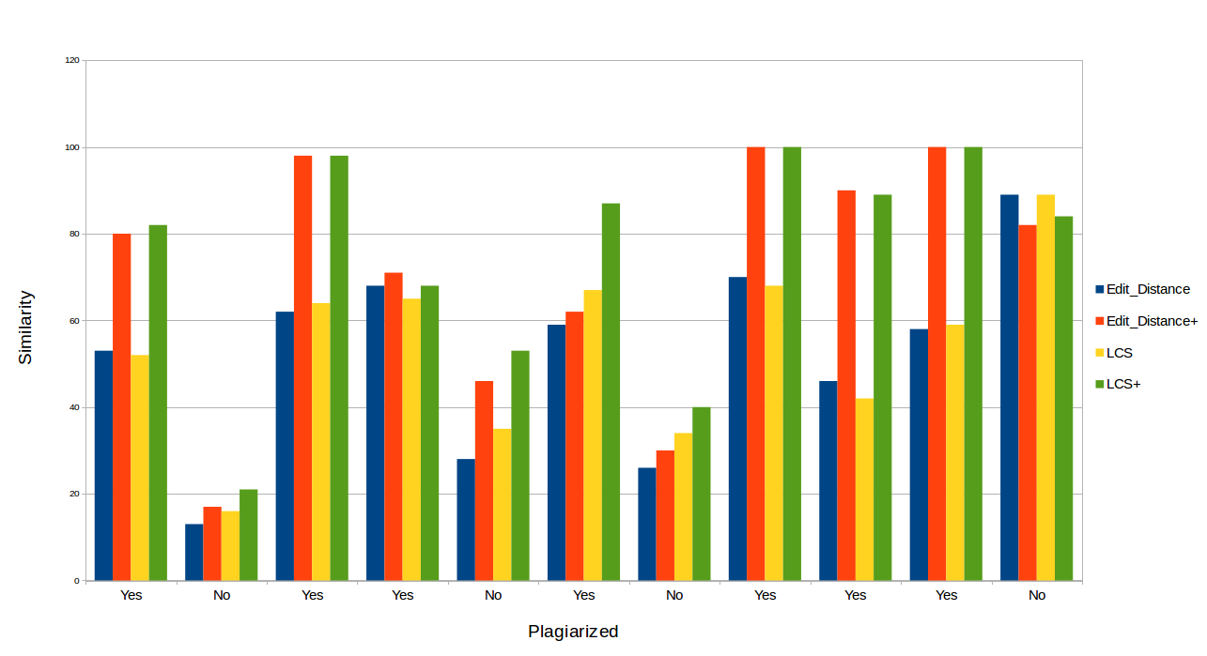
Comparison graph for preprocessed and original source code similarity

Slide 21
References
http://en.wikipedia.org/wiki/Plagiarism#Academia
http://en.wikipedia.org/wiki/Plagiarism_detection
http://www.cs.utsa.edu/~wagner/pubs/plagiarism.html
http://www.ics.heacademy.ac.uk/resources/assessment/plagiarism/detectiontools_sourcecode.html
http://bongpedia.tumblr.com/post/75133328287/lyadh

Slide 22
Questions?

Slide 23
Thank You

Slide 24
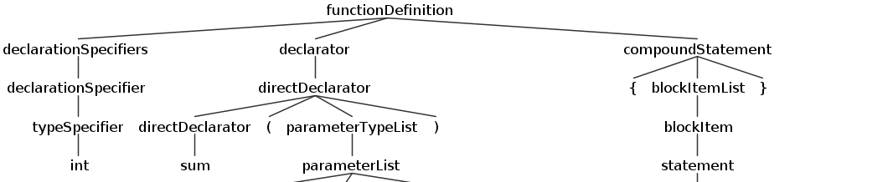
Preprocessing using ANTLR
int sum(int a, int b){ return a+b; }
(int a, int b)
return a+b;

Slide 25
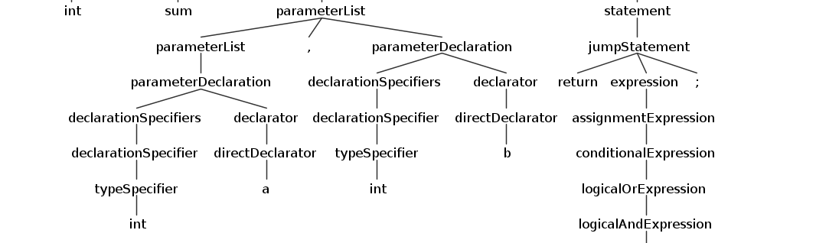
Preprocessing using ANTLR
(int a, int b)
return a+b;
a+b

Slide 26
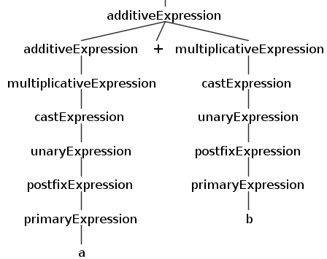
Preprocessing using ANTLR
a+b

